Slide 1
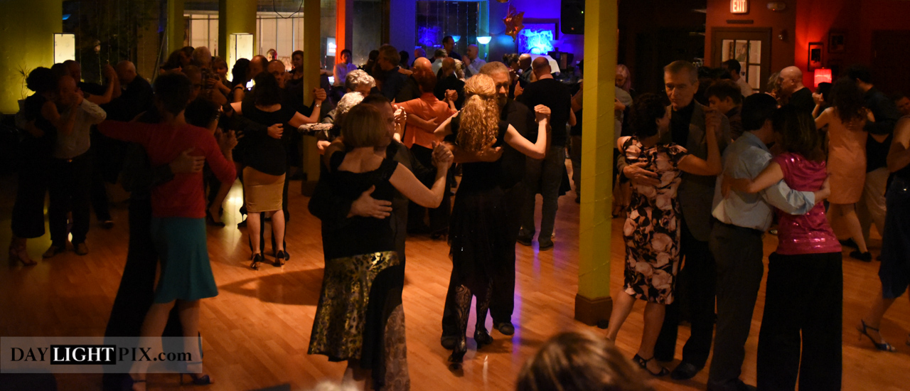
VIDA MIA MILONGA
Friday, Oct 28
Guest DJ:
David Chester
7:30 - 8:30pm: class
8:30 - 12:30am: milonga
Dance Union, 16 Bow St, Somerville, MA
TangoAffair.com
every 4th Friday
of the month
in Boston

